Slide 1

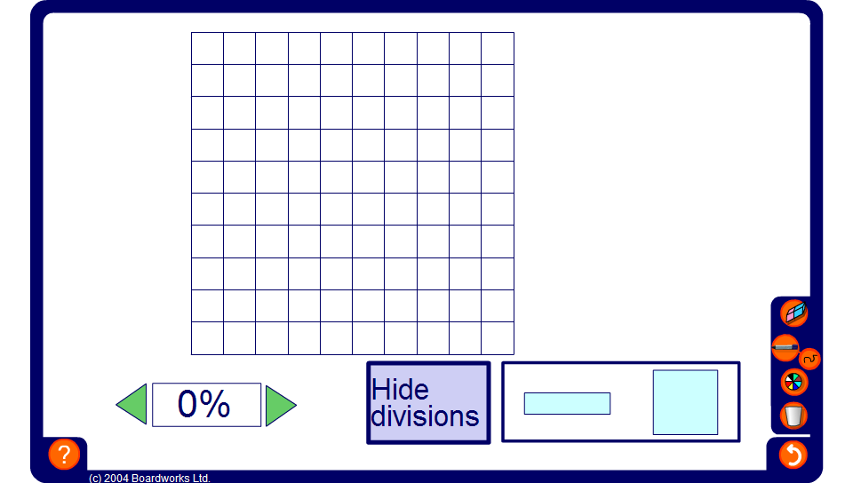


Percentages of shapes
Notes:
Use this activity to demonstrate various percentages on a square and on a bar.

